Slide 1

Statistical Models for practical pooled testing
Holmes Group Meeting, 14 May

Slide 2
Research Objectives
Big Picture: Demonstrate changes in pooled testing efficiency when accounting for natural deviations from IID hypotheses in the specimen collection process.
Disadvantage of pooled testing is decreased sensitivity. Can considering correlations help with this issue?
We investigate the effect of these two main deviations from the standard hypotheses on the average and tails of the distribution of efficiency metrics
Compute mathematically and demonstrate via Monte Carlo simulations.
Impact of correlation on metrics
Impact of heterogeneity on predictive metrics
Notes:
In contrast to other existing studies, we frame this problem as a distortion of the law of probability of the number of positive samples per pool — thereby allowing us to compute a correction to existing abaci, the impact on the volatility of metrics of interest, and preserving the ease of its deployment, rather than framing it within a standard optimization strategy.
PPA is analogous to sensitivity when a non-reference standard test is used
Positive agreement is the proportion of comparative/reference method positive results in which the test method result is positive.

Slide 3
pooled testing advantages
Problem:
Limited laboratory capacity, delayed results, insufficient widespread testing
Testing capacity must be increased and maintained for the foreseeable future
Potentially frequent testing in wide variety of settings will be needed
Notes:
https://www.medrxiv.org/content/10.1101/2020.03.27.20043968v1.full.pdf
https://wwwnc.cdc.gov/eid/article/27/4/20-4200_article
Graphic: https://perkinelmer-appliedgenomics.com/2020/11/06/covid-19-sample-pooling/

Slide 4
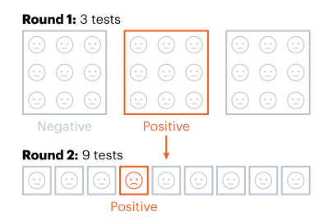
Background
Pooled testing: combining samples from several people and conducting one laboratory test on the combined pool of samples
Dorfman 2-stage pooling →
More complicated methods may be more “optimal”, but 2-stage Dorfman is practical
Notes:
If a pooled sample is negative, all individuals in the pooled sample are deemed negative. If the pooled sample is positive, the individual samples from the pool are then tested.
https://www.cdc.gov/coronavirus/2019-ncov/lab/pooling-procedures.html
https://idss.mit.edu/wp-content/uploads/2020/04/04.28.2020pooled_testing.pdf
https://www.nature.com/articles/d41586-020-02053-6

Slide 5
Standard paradigm
Given a sensitive test and low disease prevalence, testing capacity increases dramatically with pooled testing
Previous work specifically avoids settings where individuals have high probability of being positive (e.g. Sinnott-Armstrong et al 2020)
“Routine” approach: first sample pools are assembled randomly in the laboratory for analysis
Assumes samples are independent! (# positives in a group has binomial distribution)

Slide 6
The pooled testing tradeoff
Advantages
Minimize average number of tests per person
More testing using fewer resources
Limitations
Optimal Pool Size, Feasibility of strategy
Dilution & Analytic Sensitivity
Disease Prevalence
Notes:
Key principles for successful application of group testing involve knowledge of the limit-of-detection, sensitivity, and specificity of the assay, and the prevalence of disease in the population. The goal of the process is to determine a pool size that provides the greatest conservation of resources while maintaining the reliable performance of testing.
TRADEOFF: larger pools save more resources, but they also dilute samples more and make it harder to detect presence of virus
Nebraska public health study: https://academic.oup.com/ajcp/article/153/6/715/5822023

Slide 7
The Pooled Testing Tradeoff: Prevalence
Based on empirical data:
Prevalence <0.6%: pool size=20 requires the fewest tests
Prevalence >3%: pool size=5 requires fewest tests
Prevalence >28%,: individual testing optimal
Notes:
Figure source: https://wwwnc.cdc.gov/eid/article/27/4/20-4200_article

Slide 8
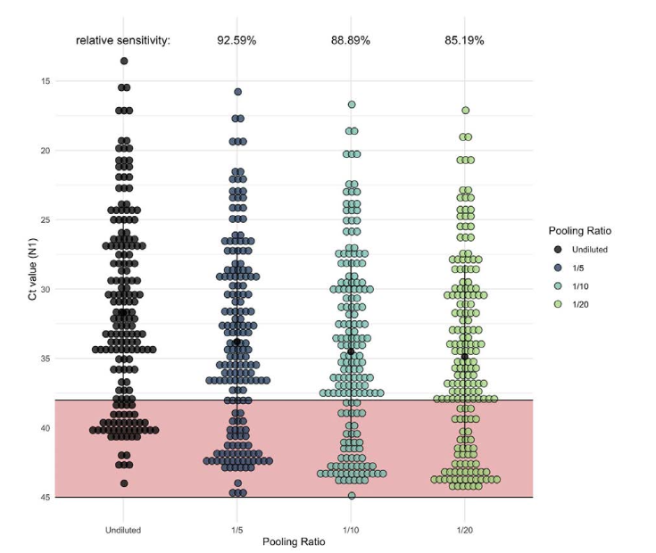
The pooled testing tradeoff: Dilution
Pooling samples → dilution → decreased sensitivity
Based on empirical data:
Pool Size | Sensitivity (relative to sensitivity of unpooled samples)
5 | 92.59% (95% CI 88.89%–95.56%)
10 | 88.89% (95% CI 80.00%–91.85%)
20 | 85.19% (95% CI 75.56%–91.11%)
“The benefits of pooled testing will always be accompanied by decreased detection sensitivity. ” (Watkins et al, 2021)
Notes:
Summary: as pool size increases, more samples are classified as negative (false negatives) in comparison to samples tested individually (unpooled). Line represents Ct=38
Pooling samples can also potentially dilute the viral genetic material of a positive sample beyond the assay’s Limit of Detection (LoD), thus increasing the likelihood of false negative results
A test that registers a positive result after 12 rounds, for a CT value of 12, starts out with more than 10 million times as much viral genetic material as a sample with a CT value of 35)
low Ct values indicated the presence of higher amounts of viral RNA and high Ct values indicated lower amounts.
Pooling samples INCREASES the Ct
Key principles for successful application of group testing involve knowledge of the limit-of-detection, sensitivity, and specificity of the assay, and the prevalence of disease in the population. The goal of the process is to determine a pool size that provides the greatest conservation of resources while maintaining the reliable performance of testing.
TRADEOFF: larger pools save more resources, but they also dilute samples more and make it harder to detect presence of virus
Sensitivity = proportion of people who have disease that are correctly identified as positive
Combining specimens → dilution → lower concentration of viral genetic material, possibly below the limit of detection of test
Larger pools → higher probability of false-negatives
Figure and data from: https://wwwnc.cdc.gov/eid/article/27/4/20-4200_article

Slide 9
Dilution
C_{t} Value = Cycle Threshold Value
Number of PCR cycles needed to detect the virus
No detection after 37 to 40 cycles = negative test
Indicates how much virus an infected person has
Notes:
Summary: “The benefits of pooled testing will always be accompanied by decreased detection sensitivity. However, the lower overall number of tests required and the lower associated costs expands testing capacity, permitting more frequent testing, and testing persons more often mitigates the loss of sensitivity”
Figure and data from: https://wwwnc.cdc.gov/eid/article/27/4/20-4200_article

Slide 10
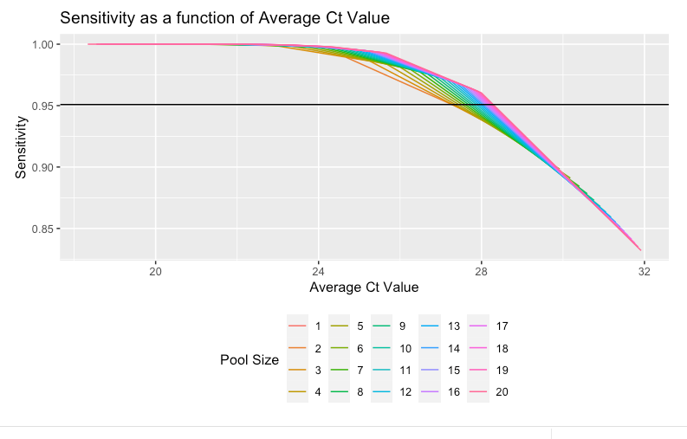
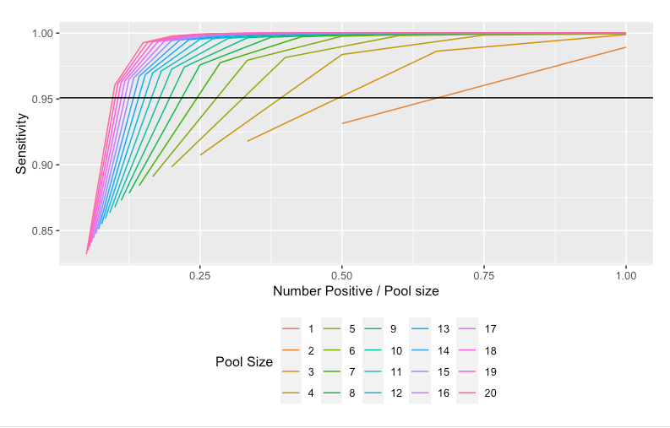

Slide 11

correlations
> 400 PubMed results for “covid pooled testing”
This trade-off has often been studied in settings where the specimens are considered independent and identically distributed (IID), showing moderate efficacy gains compared to individual testing
SARS-CoV-2 virus: these assumptions are often violated
How does this change our recommendations for implementation of pooled testing?
Practical effects of correlations have not been well studied
Correlations
Prevalence
Efficiency
Dilution
Notes:
-pooled testing has been done already, but importance of correlation has not been taken into account
-a setting where statistics can help! We can model to help people understand the properties of group testing. How does pooled testing effect the sensitivity? It is also a function of how much viral material is in a sample.

Slide 12
Infectious disease networks
Relations between individuals (families, office colleagues or neighbors, passengers on airplane) determine risk of infection
Notes:
Figure based on contact tracing done in Canadian health system in January 2020
Social network diagram of households with COVID-19 cases in the Winnipeg Health Region; green dots represent primary cases, red dots represent secondary cases, and yellow dots represent asymptomatic household contacts; lines connect case(s) to named household contacts
Figure Source: Secondary attack rate of COVID-19 in household contacts in the Winnipeg Health Region, Canada
https://www.ncbi.nlm.nih.gov/pmc/articles/PMC7671665/

Slide 13
1. Pooled Testing under correlations
Pooled testing in non-IID settings: effective parameters, effect on metrics of interest
Distorts number of positive samples per pool
Shifts the effective number of samples and prevalence level
→ inaccurate estimates of the efficiency of pooled testing and degree of dilution
Notes:
These deviations from standard hypotheses can shift the optimal pool size by modifying the inputs along two orthogonal dimensions:
effective pool size is typically smaller than actual pool size, due to violations of the independence assumptions and,
effective prevalence can differ from global prevalence due to violations of the “identically distributed” hypothesis

Slide 14
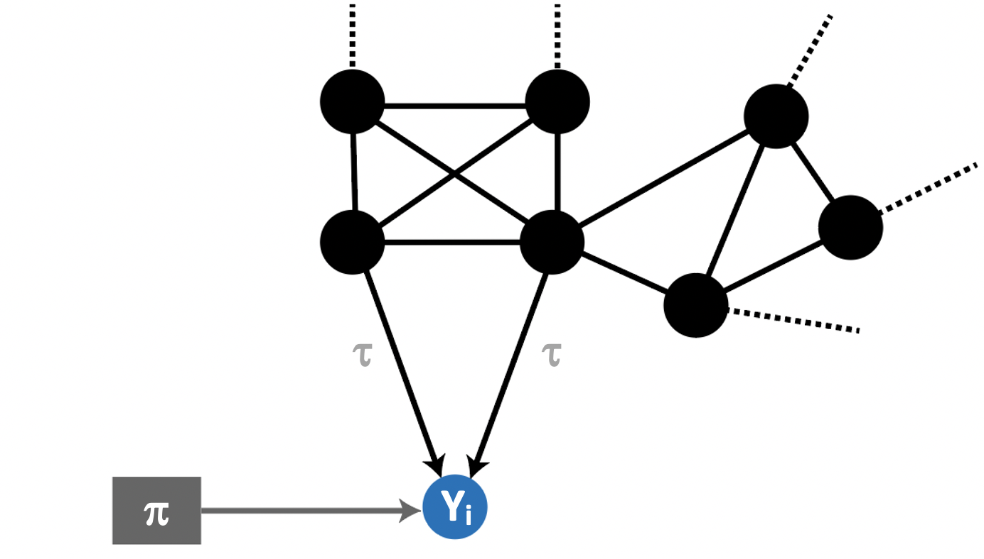
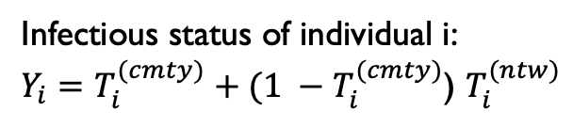
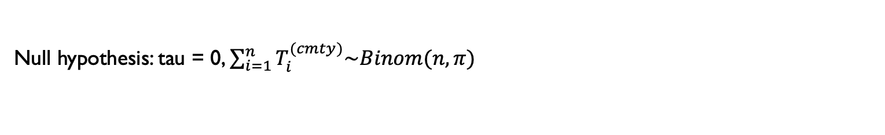
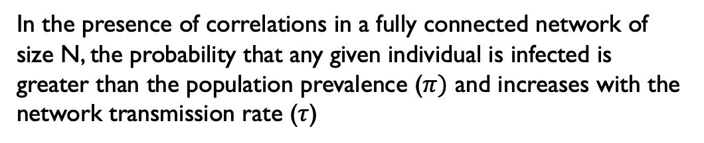
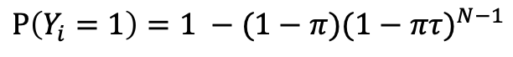
Mathematical framework: positives per pool
Infectious status of individual i:
$Y_{i}=T_{i}^{(cmty)}+(1 −T_{i}^{(cmty)}$) $T_{i}^{(ntw)}$
In the presence of correlations in a fully connected network of size N, the probability that any given individual is infected is greater than the population prevalence ($π)$ and increases with the network transmission rate ($τ$)
$$Ρ\left(Y_{i}=1\right)=1 −(1−π){(1−πτ)}^{N−1}$$
Null hypothesis: tau = 0, $\sum_{i=1}^{n}{T_{i}^{(cmty)}\sim Binom(n, π)}$
Notes:
Probability that specimen I is infected is product of community transmission probability (prevalence, pi) and network transmission probability (tau)
What the figure shows: representation of the network effect on the infectivity status for any given node. Highlights the higher risk of sample I testing positive when another sample in the network is also positive
Since specimens are correlated in a network, co-infections are much more likely than under H0
n= number of samples in each pool,
N = size of network to which the samples belong
(For now we assume n= N)
Tau = network transmission probability between individuals in the pool
Pi = population prevalence (community transmission probability)
Yi the indicator variable that specimen i is infected (Yi = 1 if individual i infected, 0 otherwise).
Since transmission can occur within the network or in the community, we decompose Yi as follows:
Let T(cmty) be the random variable indicating infection of individual i from outside i the group (community transmission), and
Let T(ntw) indicate infection from within the group i (network transmission).

Slide 15
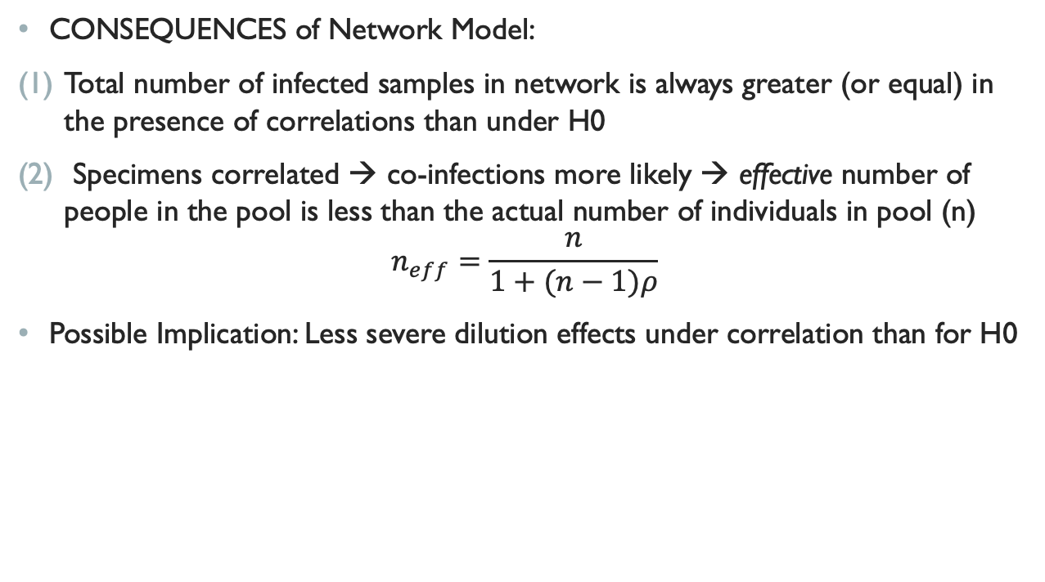
Positives / Pool
CONSEQUENCES of Network Model:
Total number of infected samples in network is always greater (or equal) in the presence of correlations than under H0
Specimens correlated → co-infections more likely → effective number of people in the pool is less than the actual number of individuals in pool (n)
$$n_{eff}=\frac{n}{1+(n−1)ρ}$$
Possible Implication: Less severe dilution effects under correlation than for H0
Notes:
Presence of correlations shifts and distorts the probability law of the number of positive samples per pool- implies that there might be less severe dilution effects under correlation than for null model
This scenario corresponds to a specimen collection process in student dorms, offices, or certain households
In this setting: Intuitively, probability p is higher than community prevalence because Specimens have the added risk of being infected by other members of the network. Moreover, since specimens are correlated, co-infections are much more likely than under H0: the “effective” number of people in the pool is less than n
Rho = the correlation between Y_i and all the other samples in the group

Slide 16
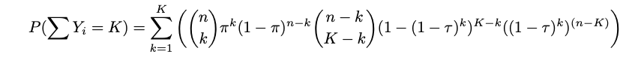
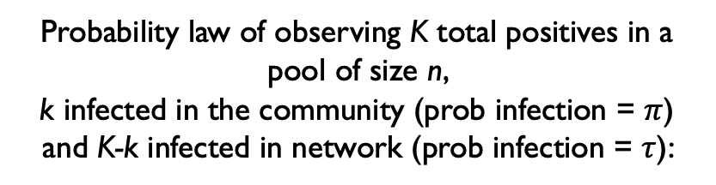
Distribution of positives / pool
Probability law of observing K total positives in a pool of size n,
k infected in the community (prob infection = $π$) and K-k infected in network (prob infection = $τ$):
Notes:
NOTES: colors are confusing; KL plot doesnt show direction; maybe shift inmedian or mode would be better to plot; not intuitive to interpre; take one slice and plot the distributions
Figure shows the KL divergence between null and alternative distribution (correlation). Difference between the two distributions increases as the pool size increases and as the netwok transmission rate increases as well
binomial distribution (probability of observing k positives in n trials (pool size) with success probability 1 − (1 − π)(1 − πτ )n−1 (corrected population prevalence)). The population prevalence is corrected to account for the fact that the probability of an individual being positive in a pool is greater when τ is greater than π.

Slide 17
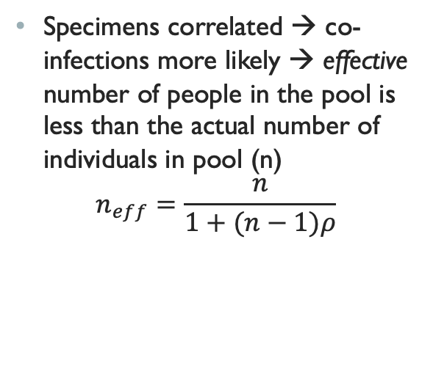
Effective Parameters in non-iid settings: pool size
Specimens correlated → co-infections more likely → effective number of people in the pool is less than the actual number of individuals in pool (n)
$$n_{eff}=\frac{n}{1+(n−1)ρ}$$
Notes:
since specimens are correlated, co-infections are much more likely than under H0: the “effective” number of people in the pool is less than n.

Slide 18
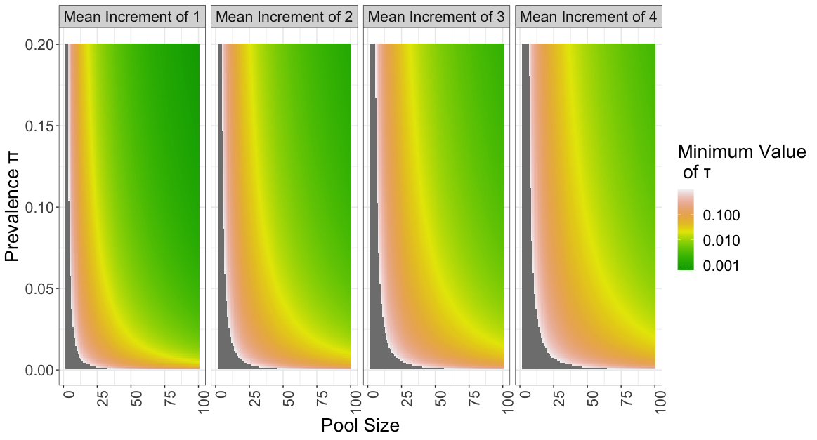
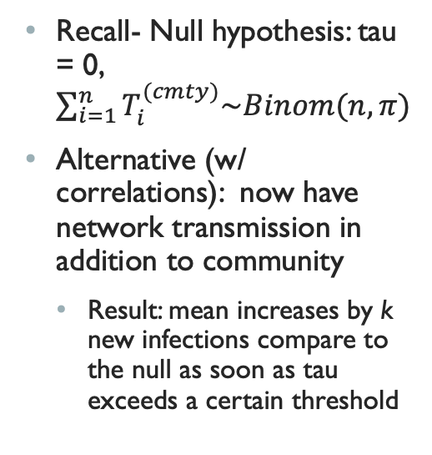
Effect of tau
Recall- Null hypothesis: tau = 0, $\sum_{i=1}^{n}{T_{i}^{(cmty)}\sim Binom(n, π)}$
Alternative (w/ correlations): now have network transmission in addition to community
Result: mean increases by k new infections compare to the null as soon as tau exceeds a certain threshold
Notes:
Figure shows: Minimum value of tau required to shift the expected number of infected samples in a pool by k as a function of the pool size and the overall community prevalence pi (grey indicates NA values)

Slide 19
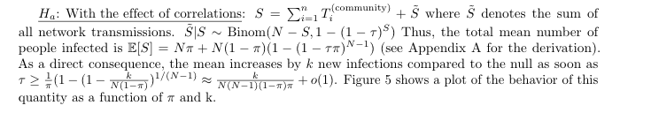

Slide 20
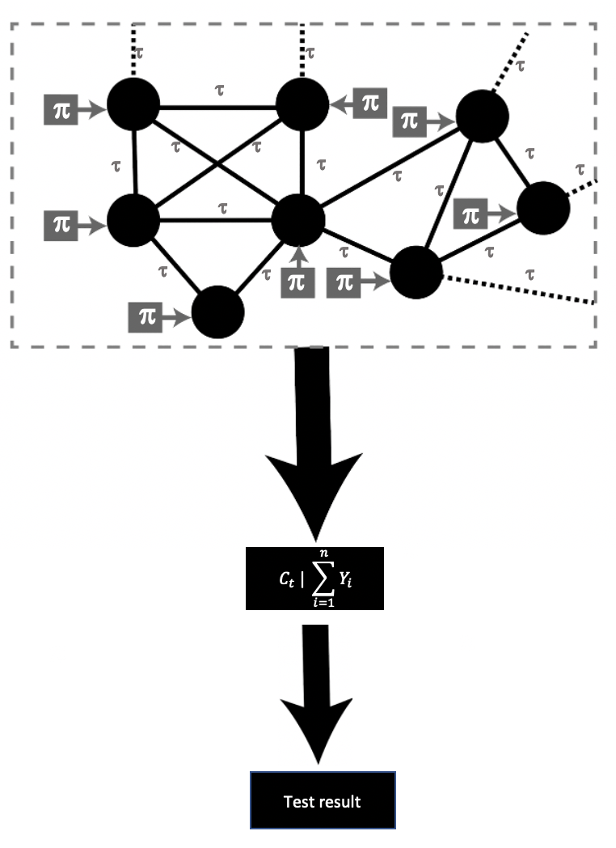

Performance depends on positives/pool
All metrics to evaluate the performance of pooled testing (Sensitivity, Expected number of tests per sample) only depend pi, tau, and pool size through their dependence on the number of positive samples in the pool
$$Sens=Ε\left(Sens | \sum{Y_{i}}=k\right)∗ Ρ\left(∑Y_{i}=k\right)$$
Therefore, critical to understand the distribution shift in number of positive samples/pool in the presence of correlation

Slide 21
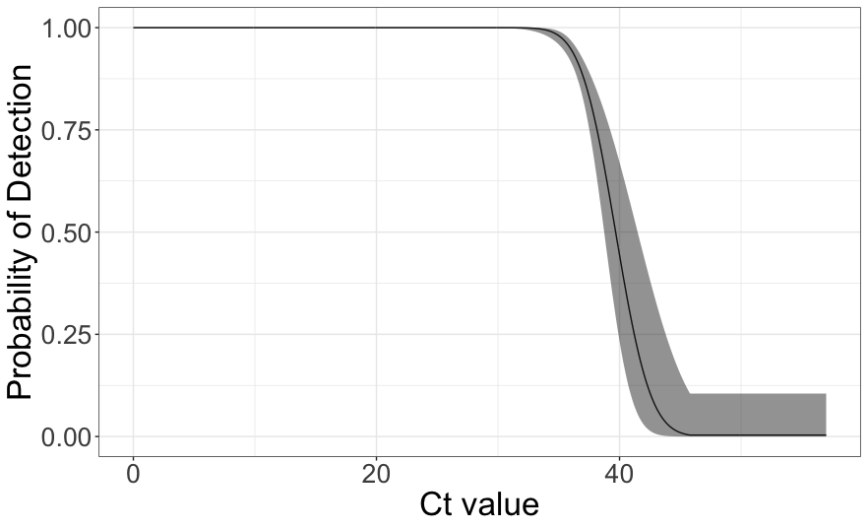
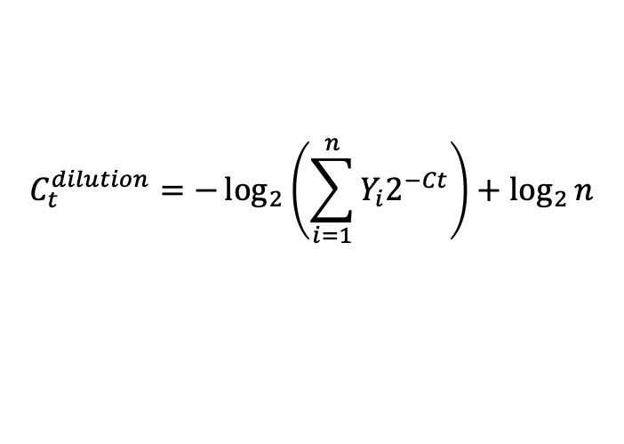
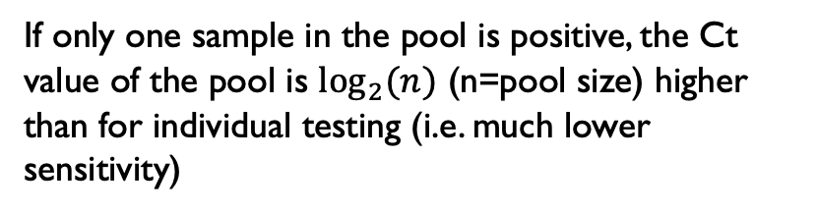

Effect of Positives/pool on Ct
T = fluorescence required for PCR to register as positive
n⁽⁰⁾=viral load of sample
At every PCR cycle, viral RNA is ~doubled → an indirect measure of viral load in the sample:
$$T= n^{(0)}2^{Ct} ⟹C_{t}=\log_{2}{(\frac{T}{n^{\left(0\right)}})}$$
If only one sample in the pool is positive, the Ct value of the pool is $\log_{2}{(n)}$ (n=pool size) higher than for individual testing (i.e. much lower sensitivity)
$$C_{t}^{dilution}=−\log_{2}\left(\sum_{i=1}^{n}{Y_{i}2^{−Ct}}\right)+\log_{2}{n}$$
Notes:
Recall: Ct value Is the number of cycles needed to amplify viral RNA to reach a fixed background level T of fluorescence, at which point the diagnostic result of the PCR test changes from negative (not detectable) to positive (detectable). Since at every cycle the amount of viral RNA is roughly doubled, it is thus an indirect measure of the viral load of the sample

Slide 22
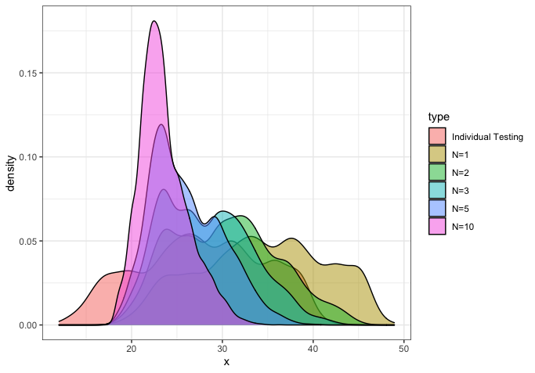
Effect of Positives/pool on Ct
Important consequences:
1. Maximum increase in Ct value occurs when one sample in pool is positive – translate sensitivity curve by log2(pool size)
$$C_{t}^{dilution}=C_{t}^{individual}{+\log_{2}{n}}$$
2. For a larger number of positive samples, the dilution actually has a positive effect and lowers the Ct value, leading to increased sensitivity
Notes:
Plot shows density of Ct values for pool size=100 as the number of positives increases. Colors are different number of positives

Slide 23
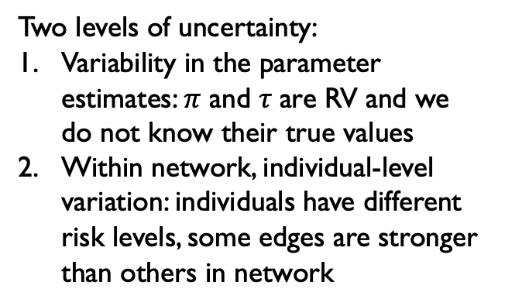
2. Pooled Testing w/ variability & Uncertainty
Impact of heterogeneity on predictive metrics
Two levels of uncertainty:
Variability in the parameter estimates: $π$ and $τ$are RV and we do not know their true values
Within network, individual-level variation: individuals have different risk levels, some edges are stronger than others in network
How to select the transmission rate given data?
What is the impact of the added effect of this heterogeneity? – need to quantify uncertainty in our estimates
Notes:
Compared to existing studies, we aim to provide confidence bounds, and account for the variability in correlations and exposure risks in the population.
NON-IID SETTINGS
How does expected performance of pooling procedure change when IID assumptions are violated?
Mathematical derivation and simulation
IID: assume that the underlying diagnostic for any given individual is independent of other test results in the pool, and that each individual has the same probability of infection
not realistic: In many SARS-CoV-2 collection scenarios, infections and positive specimens are clustered and individuals have heterogeneous infection risks de- pending on a number of variables including age, lifestyle, or occupation (among others). In particular, the sample collection process might lend itself to sample amongst networks, as measures to re-open might test student dorms, coworkers in an office, households, etc

Slide 24
Models for uncertainty
All Graph
$$π+π_{g}$$
$$τ+τ_{g}$$
𝜋+𝜋_𝑔
𝜏+𝜏_𝑔
Pi Graph
$$π+π_{g}$$
𝜋+𝜋_𝑔
Tau Graph
$$τ+τ_{g}$$
𝜏+𝜏_𝑔
Random-effect models for prevalence and transmission probability
For each network g, we have network effects for pi and tau
Compare to Fixed model

Slide 25
simulations
MCMC simulations to estimate the evaluation metrics as a function of:
1) Community Prevalence ($π$)
1) Community Prevalence (𝝅)
3) Network Transmission ($τ)$
3) Network Transmission (𝝉)
2) Pool Size
Stochastic model adapted from Wang, et al. (provided by Pinsky lab)
Notes:
We have so far considered the bias in individual parameters that non-IID assumptions induces. Now we want to consider the effect on the entire distribution. We do this via simulation
To illustrate the mathematical results that we have just shown, we adapt the stochastic model originally developed by the Pinsky lab for estimating PPA and efficiency for a two-stage pooled testing algorithm to a setting where individuals’ infection statuses (positive vs. negative) are correlated. We consider two settings: one is which we assume to test the entire network at once (in which case n = N) and one for which we only test a part of the network (n < N). For now I will just talk about the setting where we test the entire network at once
at each Ct value you have a probability of detection; above LoD (35) definitely negative, below the LoD its stochastic and there is a probability of being positive. lower Ct means easier detection
increasing proportion of positive tests is like increasing prevalence in the general population
We account for potential variability in the distribution of Ct values across subjects by fitting a Weibull distribution to empirically collected Ct distribution data, and subsequently sampling to create mock distributions where Ct values are shifted above the 95% LoD of the assay by any percentage of interest. We repeat our simulations accounting for varying proportions of the Ct values above the 95% assay LoD (x: 5.0%, 10.0%, 15.0%, 20.0%, 25.0%, 30.0%) as well. Results are presented for 15.0% of Ct values above the 95% assay LoD

Slide 26
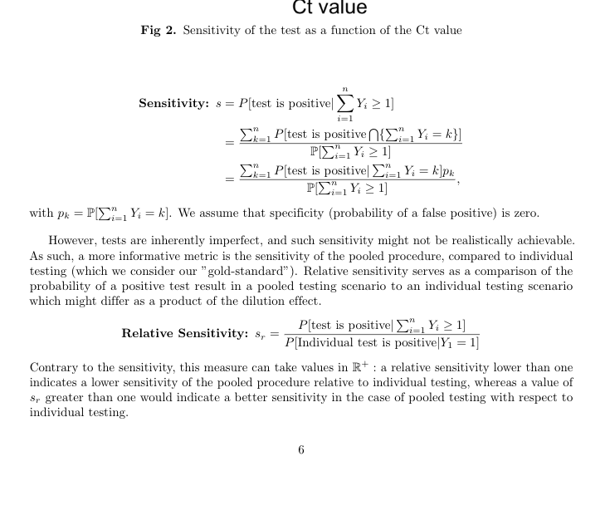
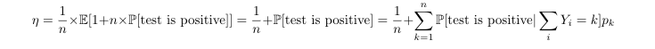
Evaluation metrics
Expected Number of Tests per Sample:
Notes:
Sensitivity = proportion of true-positives that are detected by the test, i.e. the probability of a positive test result given that there is at elast one positive in the pool
Relative sensitivity = sensitivity of the pooled procedure compared to individual testing (>1 indicates pooled testing has higher sensitivity)
Expected Number of Tests per Sample: measure of efficiency of pooled testing procedure; calculated for a Dorfman two-stage procedure
P_k is the probability that the sum of the Y-i=k.
We assume specificity (probability of false positive) is zero

Slide 27
Divergence from H0
Notes:
Here we are making a ot of assumptions
Sampling from a normal (for pi) and uniform (for tau)

Slide 28
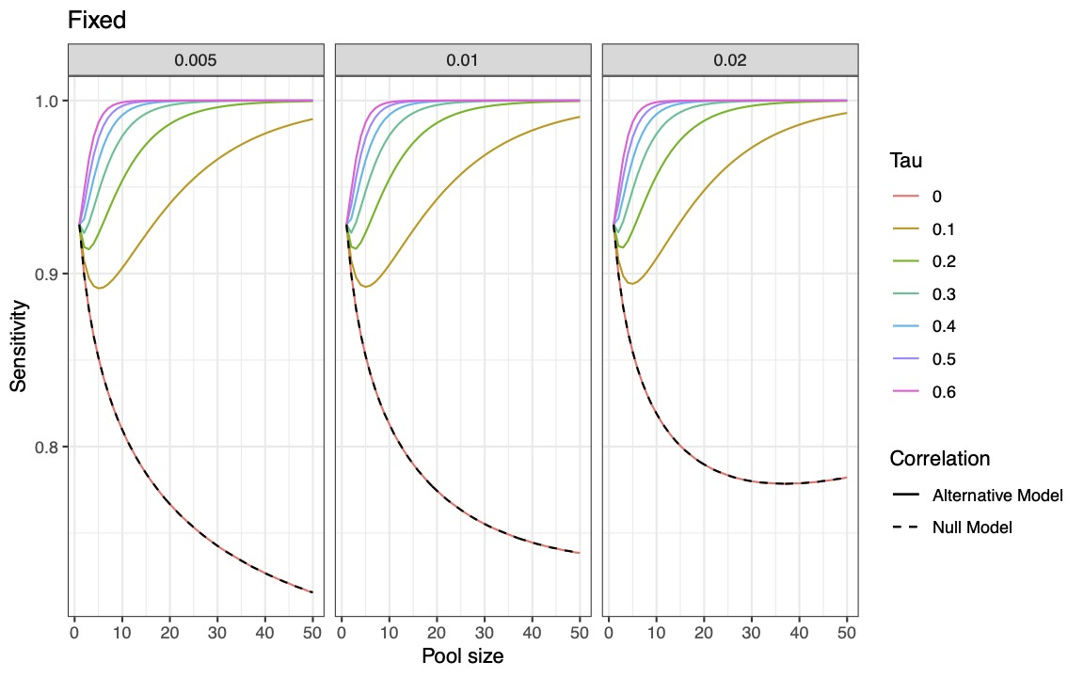
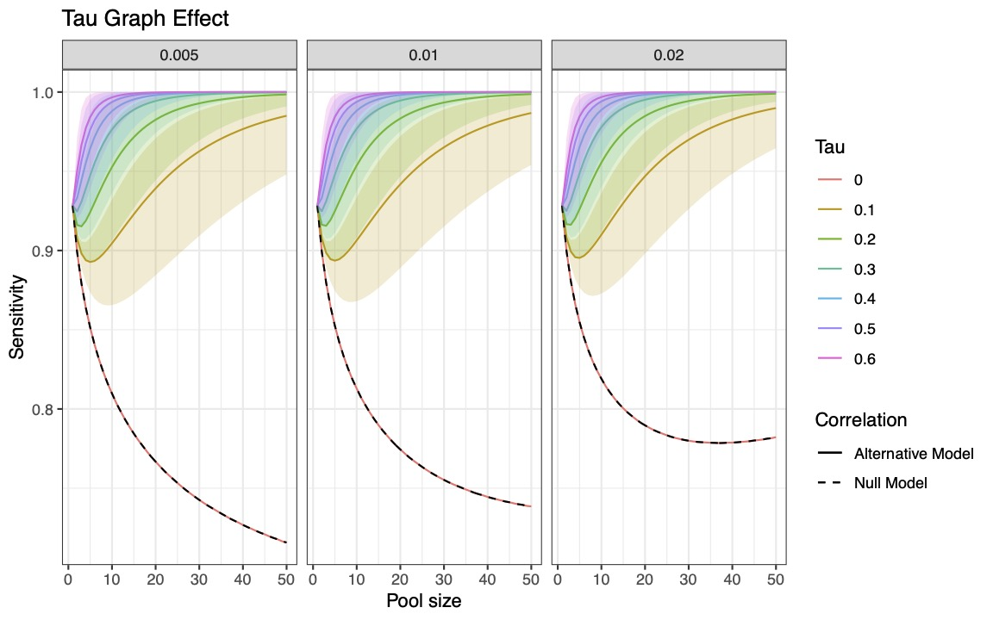
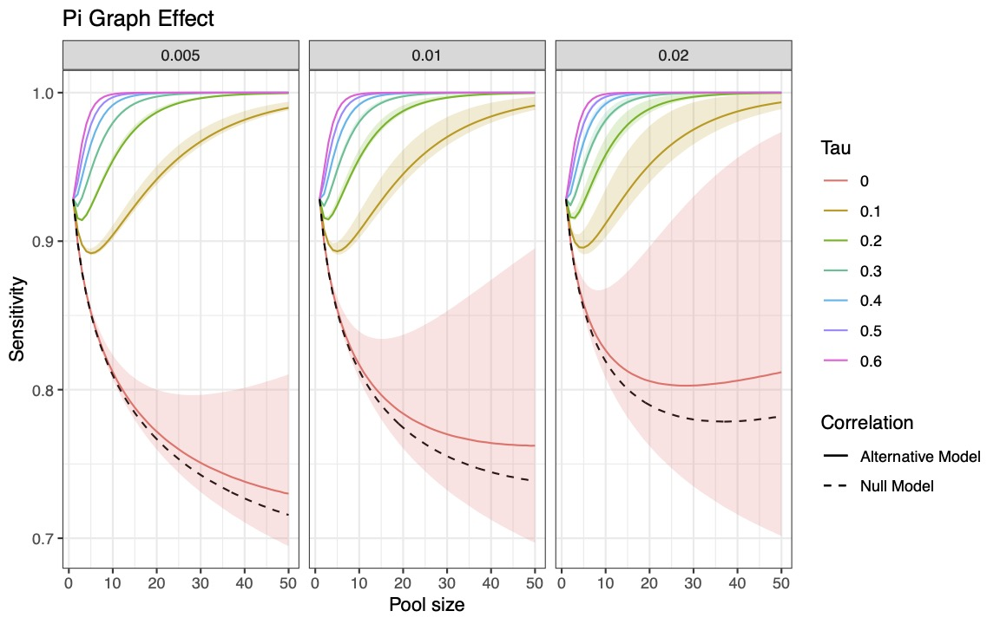
Sensitivity

Slide 29
All metrics, All graph effect
Notes:
Tau sampled from a uniform, pi sampled from transformed normal

Slide 30
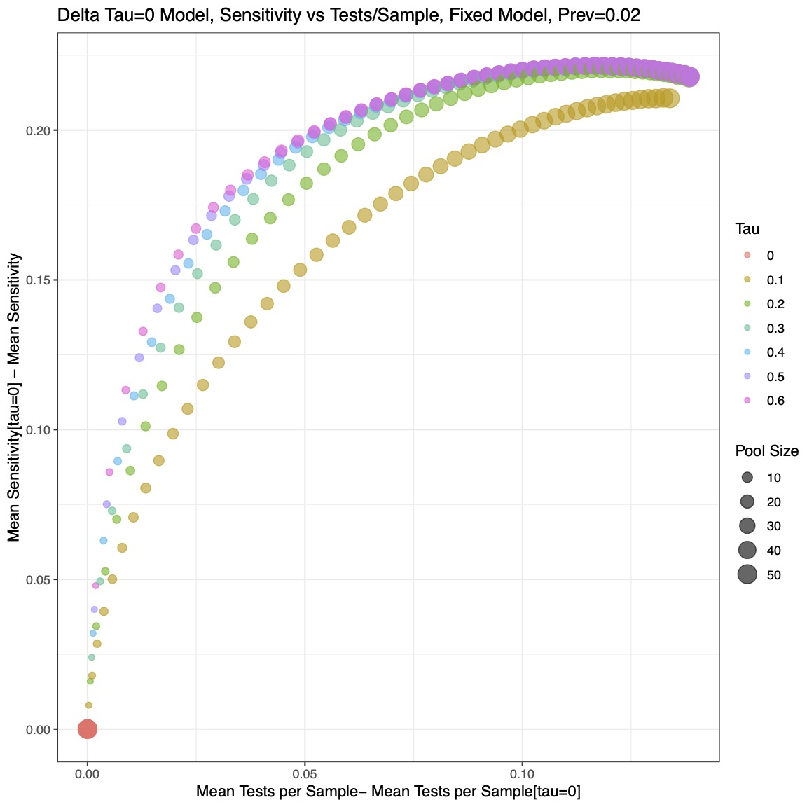
Optimizing metrics
Expected number of tests must be considered simultaneously with other metrics (poor indicator on its own: a test that is always negative has best efficiency, 1/n, but zero sensitivity)
Consider area under the curve of sensitivity vs. number tests / sample as pool size varies
Notes:
This plot is for the fixed model, where the axes are the difference from the respective metric for tau=0

Slide 31
AUC
Notes:
Area under the curve for the previous plot. Greatest for larger tau, larger prevalence

Slide 32
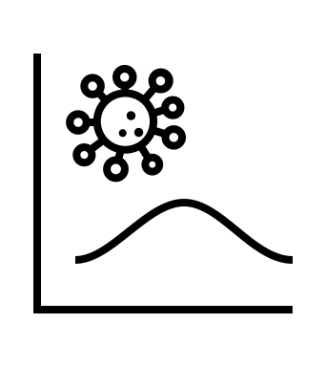

Using data to inform parameter distributions
For $τ$, $π$ and Ct

Slide 33
Ct Value distribution (adapted from pinsky et al.)
(1) Fit C_{t} values of positive samples to candidate continuous probability distributions, select best-fitting distribution: slight negative skewness → Weibull distribution (shape = 4.55, scale parameters = 29.86)
(2) Generate set of random C_{t} values: sample 50,000 times from this distribution (base case); shift C_{t} values to have 5-30% of values above LoD (to test differing viral loads)
Notes:
Best fitting distribution selected based on the Bayesian information criterion and Kolmogorov-Smirnov statistic (0.0436).

Slide 34
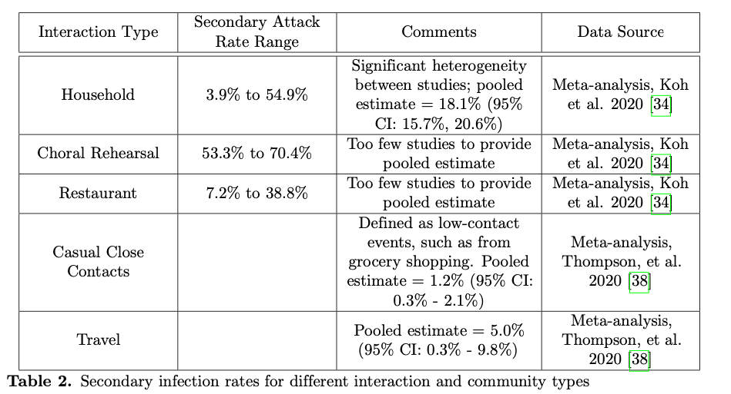
Heterogeneity in transmission
Notes:
Transmission estimates vary vastly across studies and subjects. Similarly, among people in the same community, exposure risks vary depending on one’s occupation (healthcare workers, school teachers, retailers, or remote workers) — thus begging the question: in light of this heterogeneity, how to select the transmission rate? What is the impact of the added effect of this heterogeneity? In other words, the focus of this section is on providing confidence bounds to the curves provided in the previous section.
Shows magnitude of correlation and significant variability

Slide 35
Informed priors: tau
Data on Secondary Attack Rate (SAR) from 207 household clusters of varying sizes
Problem: very zero inflated
EM algorithm does not converge
Fit distribution using Beta Binomial

Slide 36
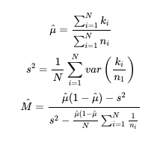
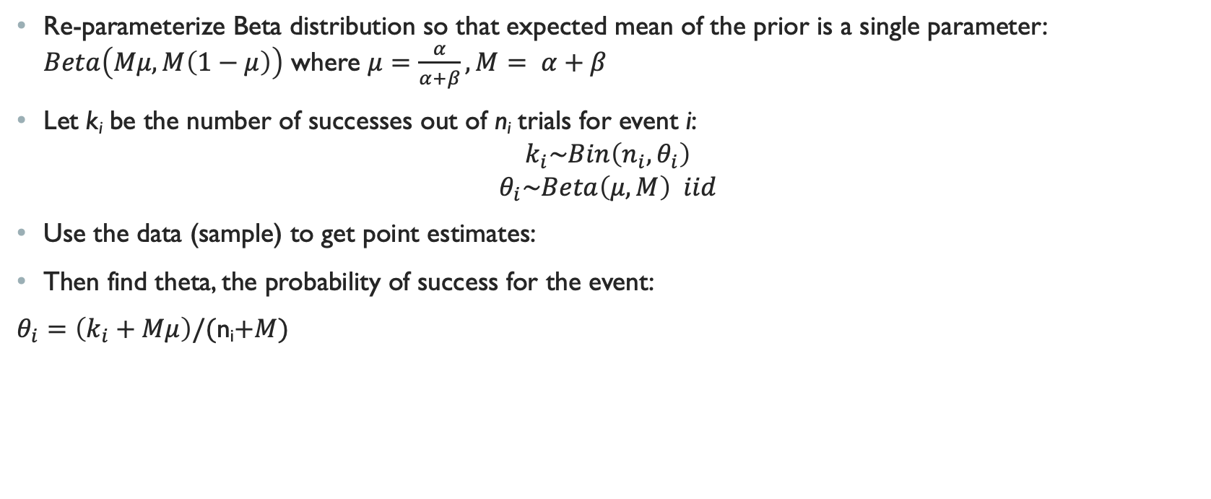
Tau Distribution
Re-parameterize Beta distribution so that expected mean of the prior is a single parameter: $Beta\left(Mμ, M\left(1−μ\right)\right)$ where $μ=\frac{α}{α+β}, M= α+β$
Let k_{i} be the number of successes out of n_{i} trials for event i:
$$k_{i}\sim Bin\left(n_{i}, θ_{i}\right)$$
$$θ_{i}\sim Beta\left(μ, M\right) iid$$
Use the data (sample) to get point estimates:
Then find theta, the probability of success for the event:
$θ_{i}=\left(k_{i}+Mμ\right)/($n_{i}$+M)$

Slide 37
Fitted distribution: tau

Slide 38
Sampling tau from fitted distribution

Slide 39
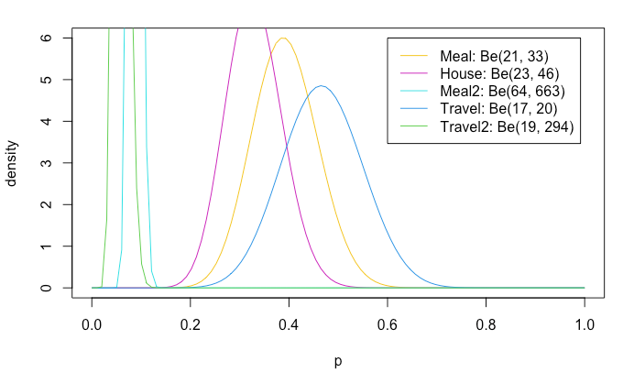
Tau Distribution
Fitted Beta distributions to 95% CI from published literature for SAR in different settings – but get very different results from prior fitting method
Need to think more about how to get reasonable tau distributions

Slide 40
Parameter distributions: Pi
Ideas about how to fit a distribution to these data??
Notes:
We want a more informed distribution for our pi values
plotting two time series against each other; could model using a time series (better off separating these and not plotting one against the other)

Slide 41
Summary
Specimen collection process could have natural correlation process (e.g. dorms, offices) that we want to account for; frequent and widespread testing potentially needed for a long time
Two effects
Correlations: higher probability of positive pool → potentially need to lower pool size, but reduces concerns about dilution effects and decreased sensitivity
Heterogeneity: gives idea of distributions on the values (average number of tests per sample is a RV, how sure are we of the gains that we are proposing?)
Given the uncertainty we have in the parameters themselves, how does this translate into our estimates?
Higher heterogeneity means wider spread
Notes:
Especially interested in how we can make this useful / interesting to people working on COVID / infectious disease
If we see gains on average, are there scenarios where it might be worse?
Also a reflection of how certainty we are of our estimates (we use informative parameters, but they are still guesses)
Narrow spread = consistent gains; Wide spread = not very confident in average value
E.g. a gain of 40% on average, is the uncertainty (30-50%) or (-10-50%)?

Slide 42

Thanks for listening☺
Holmes Group:
Claire Donnat, PhD
Susan Holmes, PhD
Pinsky Lab:
Hannah Wang, MD
Catherine A. Hogan, MD, MSc
Benjamin A. Pinsky, MD, PhD

Slide 43
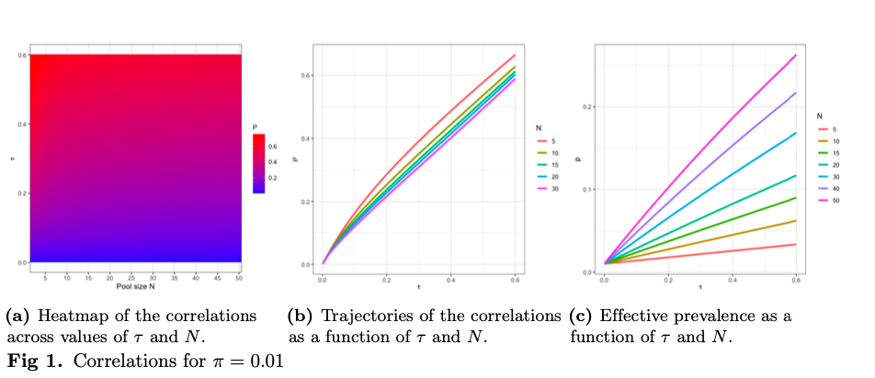
Effective Parameters in non-iid settings: Correlation & prevalence
Notes:
Tau is a generic notion of transmission between individuals – want to map it back to correlation between two samples in the pool. Here, correlation between two samples in a pool is a function of pi, tau and N. When we have small values of pi and N, the correlation simplifies to just a function of tau and N
In the null model, the probability p of each individual sample being positive equals the community prevalence. Here we examine the effective prevalence
(a) Across all pool sizes, as the transmission probability between individuals in the pool (tau) increases, correlation increases
(b) Shows same thing as (a)
A and b show that for small pi (and reasonable network sizes), the correlation is roughly similar to the transmission rate and it is independent of the prevalence
(c) As tau increases, the effective prevalence increases across all group sizes

Slide 44
Simulations: Homogeneous community exposure risk, non-independent
For each combination of prevalence and pool size (and % greater than LoD), we calculate the expected number of tests per sample and the PPA, both weighted by the probability of observing k positives in that pool
True population: correlated individuals
Null mode: Ignore correlation – erroneously treat as IID
Expected number of positives per pool has binomial distribution
Alternative: Correctly consider networks of correlated individuals
Expected number of positives per pool computed exactly
Notes:
Simulate as if testing a population of correlated individuals, where we either ignore correlation and erroneously treat the individuals as independent (H0), or correctly consider networks of correlated individuals (Ha). Probabilities are calculated as specified on the previous slides:
null model, we make i.i.d assumptions and the expected number of positives per pool has a binomial distribution (probability of observing k positives in n trials (pool size) with success probability 1 − (1 − π)(1 − πτ )n−1 (corrected population prevalence)). The population prevalence is corrected to account for the fact that the probability of an individual being positive in a pool is greater when τ is greater than π.
alternative model Ha, the probability of K positives is computed exactly under two scenarios using Equation 7 and Equation 8 (the equations I showed previously), which correspond to Poisson Binomial distributions.

Slide 45
Objectives
Pooled testing in non-IID settings
Extrapolating to global prevalence estimates
Impact of heterogeneity on predictive metrics
Develop recommendations for testing based on groups of differing risks
https://homecovidtests.shinyapps.io/Group-testing/
Notes:
alternative ways of defining effective parameters, based on the minimization of other distances between distributions (Kullback-Leibler and Total Variation distances). Compared to these methods, the method-of-moment correction that we present here has the benefit of providing an easily implementable rule-of-thumb correction. All methods are nonetheless available in our R-shiny interface.

Slide 46
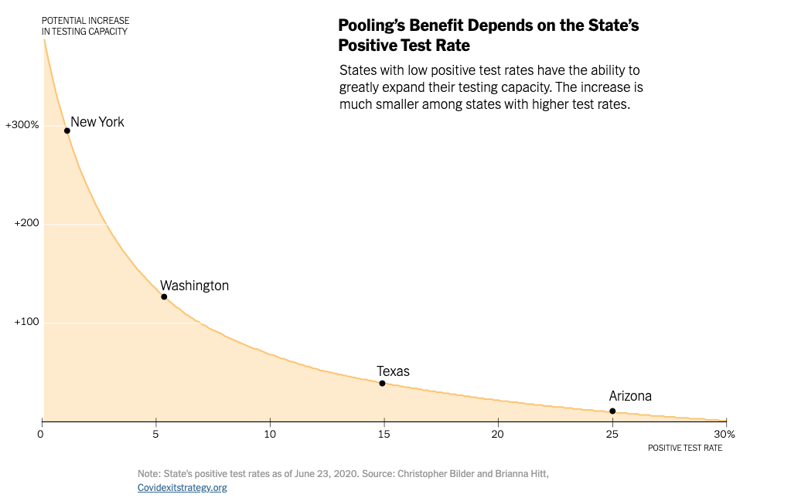
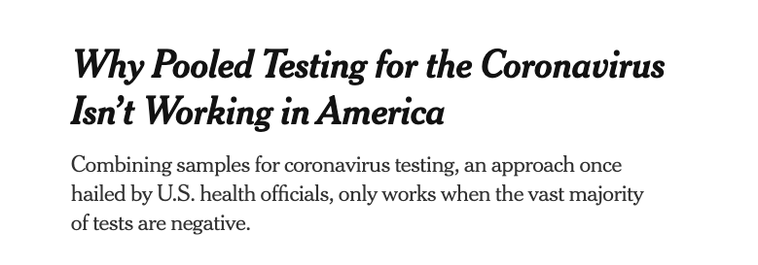
prevalence
PREVALENCE: Efficiency of pooled testing strategy decreases as prevalence increases
Lower prevalence → larger optimal pool size, less retesting needed
Most efficient when prevalence is at least less than 5% (possibly < 1%?)
Nebraska Public Health Study: one positive sample + four negatives reduced number of tests by >50 when COVID-19 prevalence < 5%
Notes:
Disease prevalence determines the probability that a pool contains at least one positive individual, and therefore, that all individuals in the pool require re-testing [29] — reducing efficacy of the method in high prevalence settings.
Nebraska public health study: https://academic.oup.com/ajcp/article/153/6/715/5822023
NYTimes: https://www.nytimes.com/2020/08/18/health/coronavirus-pool-testing.html
https://www.nytimes.com/interactive/2020/07/27/upshot/coronavirus-pooled-testing.html?action=click&module=RelatedLinks&pgtype=Article

Slide 47
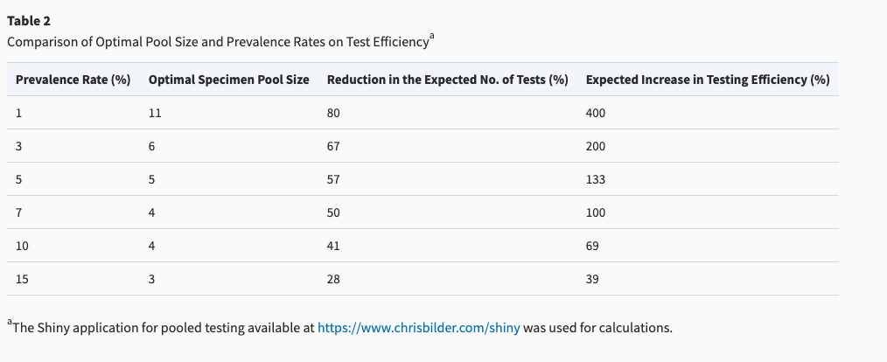
Tradeoff between prevalence and pool size
Notes:
https://academic.oup.com/ajcp/article/153/6/715/5822023

Slide 48
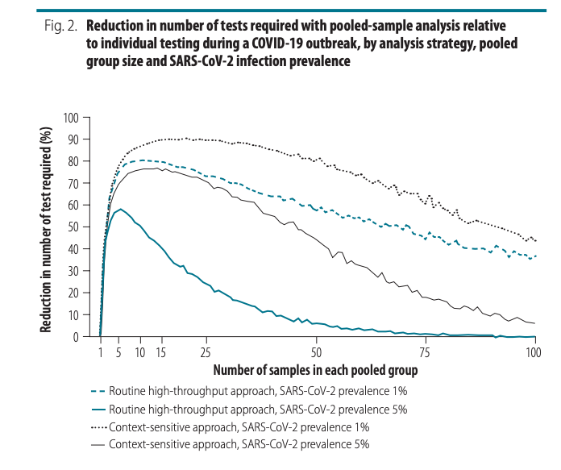
Pooling strategy
Deckert et al. (2020) simulated routine and “context-sensitive” pooling approaches
Parameters:
Population size: 150 000 or 15 000
Prevalence: 0.5 to 20%, in incremental steps of 0.5%
Group size: 2 to 100
Routine: # infected individuals in each group distributed binomial(overall prevalence, group size)
Context-sensitive:
Within group infection prevalence decreases (non-linearly) with increasing group size as group becomes more heterogeneous
# infected individuals in each group distributed binomial(within-group prevalence, group size).
Notes:
Routine: with a prevalence of 1%, selecting a group size between 5 and 50 implies at least 58% fewer tests. With a high prevalence of 10%, a reduction in the number of tests of around 40% can still be achieved but the selected group size must be close to 3. When the prevalence is high and the group size is large, the number of tests required slightly exceeds the number required for individual testing
Context-sensitive: with a prevalence of 1%, selecting a group size between 5 and 50 implies at least 76% fewer tests. With a high prevalence of 10%, a reduction of around 65% is still achievable, though the selected group size must be close to 10 (data repository)
https://www.ncbi.nlm.nih.gov/pmc/articles/PMC7463190/pdf/BLT.20.257188.pdf

Slide 49
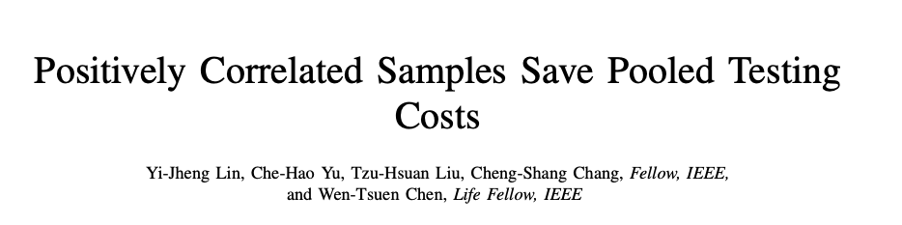
Deckert et al. (2020) showed by simulation that pooled samples from homogeneous groups of similar people lead to cost reduction for the Dorfman two-stage method
Lin et al. (2020) provide mathematical proof for this finding
Model the arrival process to a COVID-19 testing site: show that the expected relative cost for positively correlated samples is not higher than that of i.i.d. samples with the same prevalence rate
Do not account for other factors – e.g. dilution, analytic sensitivity
Notes:
expected relative cost = the ratio of the expected number of tests required by the group testing method to the number of tests required by the individual testing
Article available pre-print, Nov 2020 https://arxiv.org/pdf/2011.09794.pdf

Slide 50
overview
BACKGROUND
Mass testing is needed control the COVID-19 outbreak, but testing resources limited
Pooled testing: advantages and challenges
STANFORD POOLED TESTING PERFORMANCE STUDY
Characterized effect of dilution on analytical sensitivity through sample pooling using empiric data and modeling
Assume all samples are IID
CORRELATION STRUCTURES
How does test sensitivity change when independent and identically distributed assumptions are violated?
Two models for introducing correlations
Correlation in Ct values
Correlation at transmission level (network model)

Slide 51
“SARS-CoV-2 Pooled Test Performance” (Pinsky Lab, Stanford)
LAB METHODS:
Tested 1,648 prospectively-pooled specimens
C_{t} result between 40-45 = indeterminate result; > 45 = negative
STATISTICAL METHODS:
Developed simulation model to estimate the effects of dilution on positive percent agreement (PPA) and efficiency of a two-stage pooled testing algorithm
Validated model using the empiric lab data
Assumed independence between samples in same pool
OBJECTIVE:
Develop empirically validated model to predict optimal pool size and associated expected PPA based on limit of detection, C_{t} value distribution, and proportion of positive tests.
Definition {PPA}: Proportion of comparative/reference method positive results in which the test method result is positive. Sensitivity requires knowing the true status of the subject.
Notes:
In a pool with x people positive out of X total, this is the expected sensitivity (PPA).
Type of tests used: using three different NAATs for SARS-CoV-2: a laboratory-developed real-time reverse transcription PCR (rRT-PCR) assay targeting the E gene, and two commercially-available Panther System assays targeting ORF1ab
PPA: PPA is an agreement statistic for diagnostic tests. To calculate sensitivity, the true state of the subject, whether the subject does have the illness or condition, must be known.
https://analyse-it.com/blog/2020/4/diagnostic-accuracy-sensitivity-specificity-versus-agreement-ppa-npa-statistics

Slide 52
Modeling ppa (adapted from pinsky et al.)
(3) Apply model
Input parameters: PPA depends on
1) Proportion of positive tests: 0.1%, 1.0%, 3.0%, 5.0%, 10.0%, 15.0%
2) Assay analytical sensitivity:
95% assay limit of detection (LoD) C_{t} = 35
C_{t} value corresponding to the probability of detecting 95% of true positives (95% LoD). Specimens with C_{t} > LoD are assigned a decreasing probability of detection based on a probit regression curve (derived from empiric data)
3) Viral load distribution:
% of individual amplified C_{t} values above the LoD- 5%, 10%, 15%, 20%, 25%, 30%
4) Pool size: 1-20
Notes:
at each Ct value you have a probability of detection; above LoD (35) definitely negative, below the LoD its stochastic and there is a probability of being positive
lower Ct means easier detection
increasing proportion of positive tests is like increasing prevalence in the general population

Slide 53
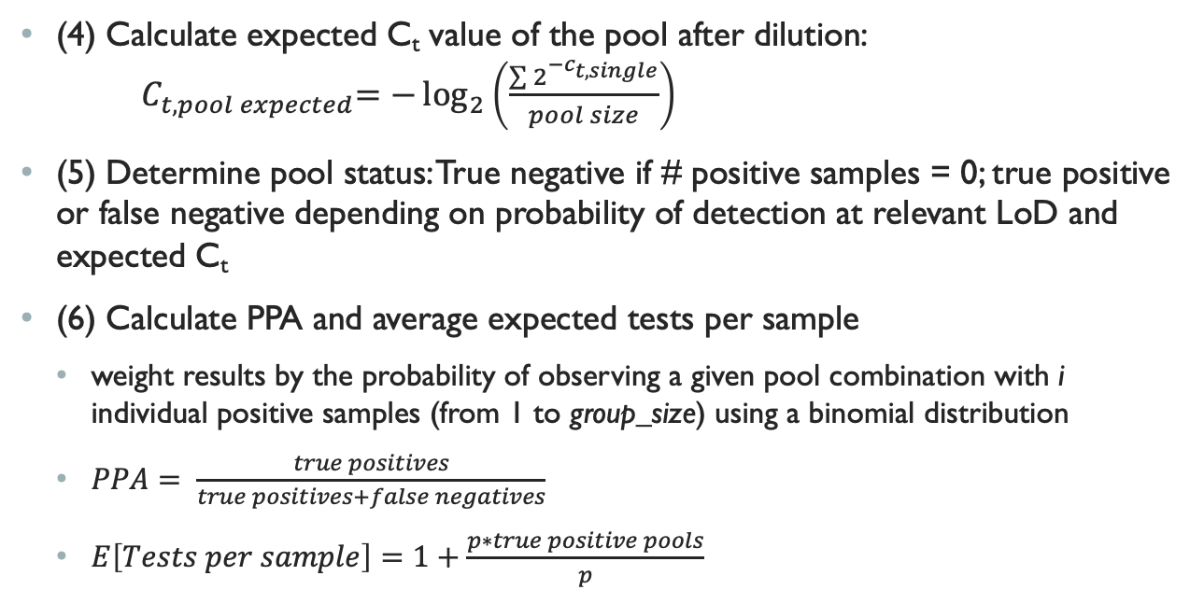
Modeling PPA (adapted from pinsky et al.)
(4) Calculate expected C_{t} value of the pool after dilution: ${ C}_{t, pool expected}=−\log_{2}\left(\frac{\sum{2^{{−c}_{t, single}}}}{pool size}\right)$
(5) Determine pool status: True negative if # positive samples = 0; true positive or false negative depending on probability of detection at relevant LoD and expected C_{t}
(6) Calculate PPA and average expected tests per sample
weight results by the probability of observing a given pool combination with i individual positive samples (from 1 to group_size) using a binomial distribution
$PPA= \frac{true positives}{true positives+false negatives}$
$E\left[Tests per sample\right]=1+\frac{p∗true positive pools}{p}$

